Slide 1
Landing Zone Framework

Slide 2
Introduction

Slide 3

What is a Landing Zone ?
Landing Zones are the holistic components of infrastructure and operations processes using a cloud platform API to enable workload deployments with confidence. Having confidence in the platform environments is key here. There are a series of best practices which are generally identified as things which should be done across different cloud platforms. It is highly recommended that these best practices and infrastructure components be deployed through code and follow a standardized, repeatable, and extensible framework
Cloud Foundations
Cloud Ready Environments
Landing Zones
Synonyms

Slide 4
Key Concepts
Landing Zones are NOT a fixed thing
Every workload migration or deployment can require foundation modifications
Landing Zone changes are FREQUENT and part of a LIFECYCLE
Landing Zones have starting points on journeys. The journey are the business operational needs which change over time

Slide 5

Overview
Organization & Technical Scope and Requirements
Automation
Build Foundation
Service Development
Cross Services
Templated Infrastructure as a Code (IaaC)
Templates
Accounts
Infrastructure
Team 1
Account Ruleset
Team …
Service Catalog
(Tenant / Role)
Governance & Compliance
Infrastructure Policies & Control
Team N
Domain-Specific Rulesets
Landing Zone Design
Reference Architecture (guidelines, standards, best practices, patterns)
Landin Zone Design
Landin Zone Implementation

Slide 6
Engagement Structure

Slide 7

Engagement Structure
01
Requirements Gathering
02
Workshops and Demos
03
Landing Zone Design
04
Landing Zone Setup
05
Feedback Loop
06
Landing Zone Update

Slide 8
Building Blocks

Slide 9
Landing Zone Design Framework
Multi-Account Structure
Identity & Access Management
Networking and Connectivity
Cloud Governance
Logging & Monitoring
Cost Control
Provisioning and Automation
Landing Zone Design

Slide 10


Multi-Account Structure
Introduction to AWS Organizations and AWS Accounts
Best practices for multi-account structure
AWS accounts and OUs requirements
Introduction to AWS Control Tower and alternative setups
Identification of the appropriate IaC tool
Structure setup

Slide 11

Cloud Governance
Naming Convention requirements and best practices
Tagging Strategy and best practices
Detective and preventive guardrails on AWS
Provide best practices for guardrail selection
Overview on developing Guardrails
Provide guidance for AWS LZ auditability

Slide 12

Identity and Access Management
Provide overview about Identity Services
Introduce various Federation strategies
Provide guidance to design identity setup and best practices
Provide support how to import your existing Identity store
Discuss authorization concepts
Provide guidance for implementation

Slide 13
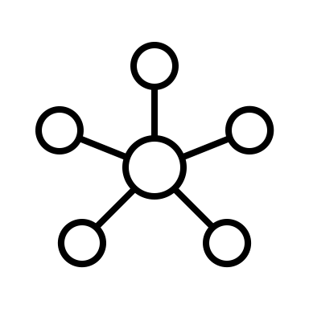
Networking and Connectivity
Give an overview about core network services
Discuss VPC design and hybrid connectivity
Provide guidance for implementation of connectivity

Slide 14

Logging and Monitoring
Discuss different approaches for centralized logging/monitoring
Introduction to AWS Logging/Monitoring services
Provide guidance for implementation of centralized logging

Slide 15

Cost Control
Introduction to CloudHealth
Provide best practices for alerting and visualization
Provide guidance for implementation of cost related topics

Slide 16

Provisioning and Automation
Provide overview about AWS Service Catalog and Account Factory
Provide guidance to implement Account Provisioning Workflow
Discuss approaches for infrastructure provisioning
Provide guidance for the implementation of infrastructure provisioning

Slide 17
Tsk-XXXX | X.XX.2020

